Slide 1
AFR Commercial Analytics

Slide 2

Agenda
01
02
03
04
05
06
Africa Commercial Analytics – Story so far
Capability Overview
Leadership and Partners
Team Structure
2022 Value Creation

Slide 3






Africa Commercial Analytics Program
2021
Delivered Suggested Order in 6 ROA Markets
$3.6M EBITDA Value Creation
2 Data Scientists Part of Larger Team
Africa
Commercial
Analytics
2022
6 Analytics Capabilities
$10M EBITDA Value Creation
Dedicated 15 Member Team(DS, MLE, DE) for Africa Commercial
2023 YTD*
7 Analytics Capabilities
$5.8 M YTD* EBITDA Value Creation
Dedicated 10 Member Team(DS, MLE, DE) for Africa Commercial
Note : * YTD represents periods between Jan to May'23
Notes:
Vijoe

Slide 4








Africa Commercial Analytics – Journey and Potential Scope
Check with Bikram, are we refreshing segmentation
Vijay to get back on non digital
Ytd numbers
Talking header points
LOGO : something like Catexpert logo embedding
In 2023 column
15 % influence point
Collaboratinng with
Tracking point – Driving Key business metrics
2024
Gen AI 1st point
Quantifying value imapcat *& alignment with finance
Explore optimization of pricing
Integration with BEES
Icons : Just keep CP&A
The Journey So Far…
AFR Comm Program 2022
AFR Comm Program 2023
2024 Focus Area
Delivered 6 analytics capability in different Africa markets
Developed end to end analytics solution and integrated on
platforms like BEES and OnCustomer
$9.7Mn EBITDA through analytics
use cases
Delivering 7 analytics solution that is operational across 7 Africa markets
Introduced Customer Stock Allocation & Target Setting solution as new capabilities in SA and NG respectively
Enhanced Algo selling capability by integrating with Lola GC model & witnessed an influence uplift of 15pp above the Global target
Partnering with key stakeholders in SA on linking BDR Algo Tasking with CX Integration and designing a framework to optimize the BDR/CX Incentives Program
Driving key business metrics to assess the solution effectiveness & business outcomes.
$5.8 Mn YTD EBITDA through analytics
Leveraging GenAI to provide valuable insights for informed decision-making.
Quantifying value impact and alignment with Finance team
Exploring optimization of pricing to drive revenue growth and improve profitability
Integrating GAC’s Solution in different BEES Platforms once launched in Africa Markets
Collaboration with cross-functional teams to explore new opportunities, strategize, and integrate analytics
Exploring new market opportunity to integrate with analytics in Africa market
Partnering with
BrewDat
BEES
OnCustomer
GCC
Global VC

Slide 5




Transform the Commercial decision-making in Africa zone by embedding Analytics across our key customer, consumer touchpoints and RTM processes to unlock and capitalize on valuable business opportunities across various Africa markets.
Ambition: Consolidating a fully End-to-End Smart Commercial Model for Africa enabled by Analytics
RTM & Africa Commercial Analytics Machine
Driving Volume with Business
Productivity & Efficiency
What will define Success?
Analyze Customer Behaviors to enhance Commercial Strategy
Adaptability and Flexibility to changing market dynamics & emerging opportunity
Expanding BDRs & CXC efforts through Targeted Actions to unlock untapped potential
Unlocking $50 Mio EBITDA Opportunity; 5% Incremental NR through algorithms; 70% NR influenced
Refining the VC methodology & Quantify the volume uplift at the budgeted MaCo Rate
Elevating performance levels in Process and WoW
Leveraging GenAI to extract actionable insights uncovering market trends
Unified Data Layer
Integration with Consumption Platforms (BEES, OnCustomer)
Tech Backbone
Full line of sight into Commercial Data by connecting to all major Data Lakes, Reporting DBs and ERP platforms
Embracing to Data Mesh Architecture in BrewDat CSA Platform enabling streamlined data governance & Agile Data Culture
Developing a Fully automated, scalable and robust capability pipeline for seamless delivery
End to End Analytics Product integrated with Downstream Consumption Platforms
Single Source of Truth for all Commercial Decision Makers on platforms like BEES Customer, BEES Grow, BEES Force, OnCustomer, etc.
Powering Key Insights across platforms used by Commercial Teams, Customers & Consumers
Strong focus and capabilities around R&D Experimentation, Productization and Impact Measurement
Enablers
Partnering with BEES, BrewDat, GCC and Teams to Accelerate Analytics Adoption

Slide 6
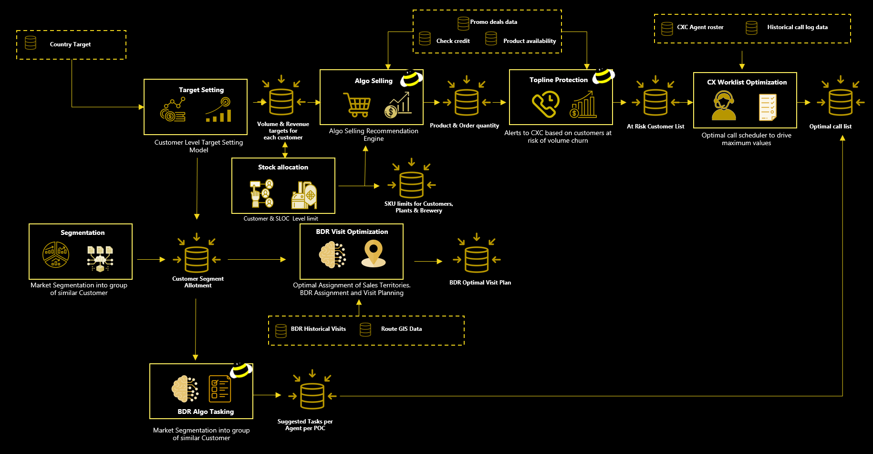
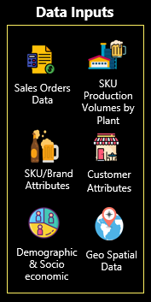
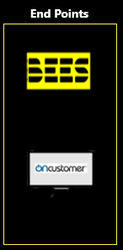
Commercial Analytics Brain
Solution Architecture

Slide 7
Capability Overview

Slide 8
Algo Selling

Slide 9













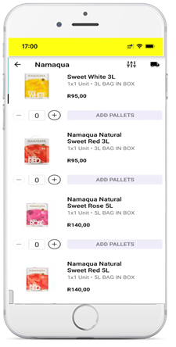





Algo Selling (Suggested order and Upsell) - Overview
Drive recommendations in BEES, tele-sales platforms & support CX teams in upselling customer orders by providing upsell and cross-sell recommendations by leveraging customer order history, product data and customer data
Live In:
Tanzania
from Jan 2021
Nigeria
from April 2021
Uganda
from July 2021
Mozambique
from July 2021
Ghana
from Sep 2021
Zambia
from Dec 2021
Methodology:
Recommendations are uploaded to BEES Lite & OnCustomer Platform
Leveraged by CX agents during sales call with customers to recommend new products
Customer
End-to-end automated pipeline using Azure DevOps
Customer places order through BEES
Intelligence fed to ordering platforms
Quick Order Recommendation Model
New Product Recommendation Model
Business Logics
to prioritize based on obsolescence risk or OOS
Customer places order through CX agent
CX agent
Transaction data from Ordering Platform
External Data
Algo Selling KPI
2023 Results
44%
Influence*
72%
Precision**
75%
Recall**
$3.2M YTD**
2023 Net Revenue Uplift
Note : 1. Influence result represents June Month for TZ 2. Precision , Recall represents periods between Jan to May’23 for TZ 3. YTD represents periods between Jan to May'23

Slide 10













Rephrase the points
Algo Selling Workflow Integrating LOLA GC Model
The integration of the Lola GC model allows us to provide customized recommendations to every individual customer.
Leveraging the Lola GC model, deliver targeted and relevant recommendations, thereby improving influence
This integration enables code reusability, enforces coding standards & streamlined model management
End Points
Choses the best model and
Increasing influence as its tailored to each customer of model revamp we are going live with upgraded model, that uses inbuilt ensemble library(taking the multiple models and choosing the best model for each customer) and Generator Component(GC component – a library build and own by GAC) that is objected to improve the influence.
Lola GC model integration provide tailored recommendation for every customer
The integration of the Lola GC model allows us to provide customized recommendations to every individual customer.
This integration improves the influence
This integration enhances our ability to positively impact customer decision-making and preferences. By leveraging the Lola GC model, we can deliver more targeted and relevant recommendations, thereby improving our influence over customer choices.
Alice's Bar
Data Sources– DMS 2.0, BrewDat, Salesforce
JFrog-repo
LOLA GC
Data pipelined from different sources to
Blob storage
Library Download
Paradise bar
Post Processing
Sales Order Data
Sales Order
SKU-Attribute
OOS-Order
Customer Attribute
Channel
Region
Segment
SKU Attribute
Brand
Pack Size/Type
Model and Data Parameters
model.json
data.json
Africa DataLake
Heuristic Model
Samantha
bar
Snowflake
Validation Framework
Holt Winters Model
MS-Teams Bot notification
Static File
Azure Data Lake
Random Forest
Ensemble Framework
Health Check (Yes/No)
Share Point
Poission’s Model
Brown's Bar
Kirungi
LightGBM Model
Salesforce
Timeseries Model
New Recommendation
Last Recommendation
BEES Data Lake
Wonderland Pagilinya
Champion Model Selection using Ensemble KPI
Algo Selling Workflow With Generator Component

Slide 11


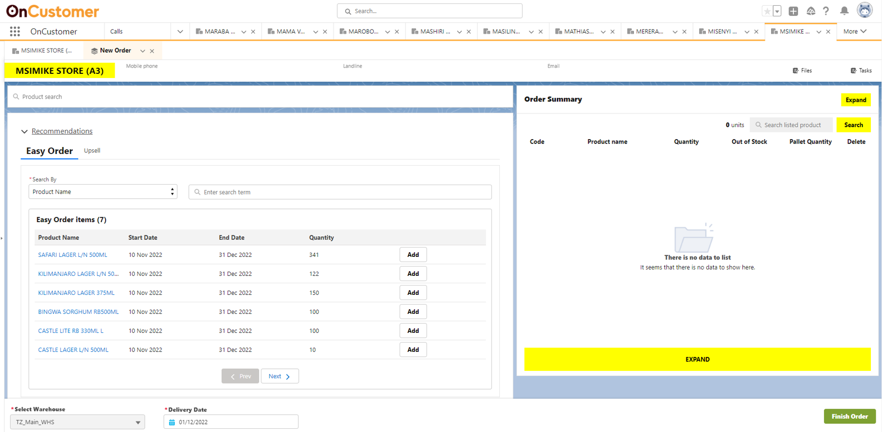

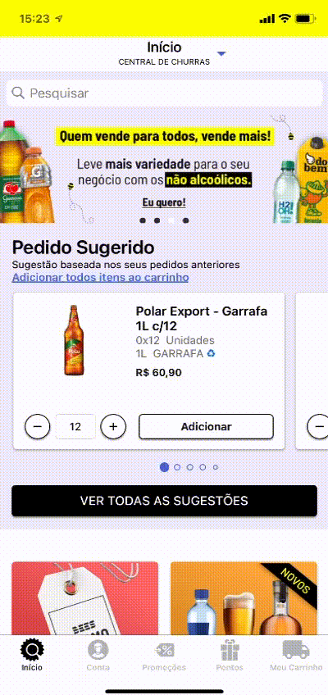
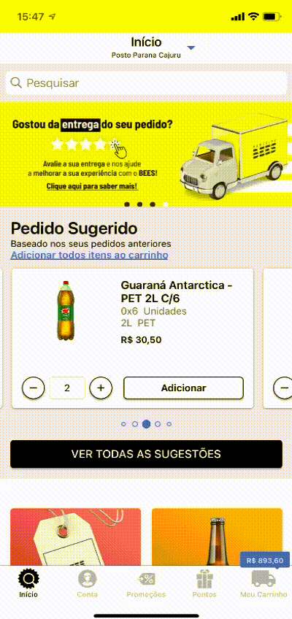
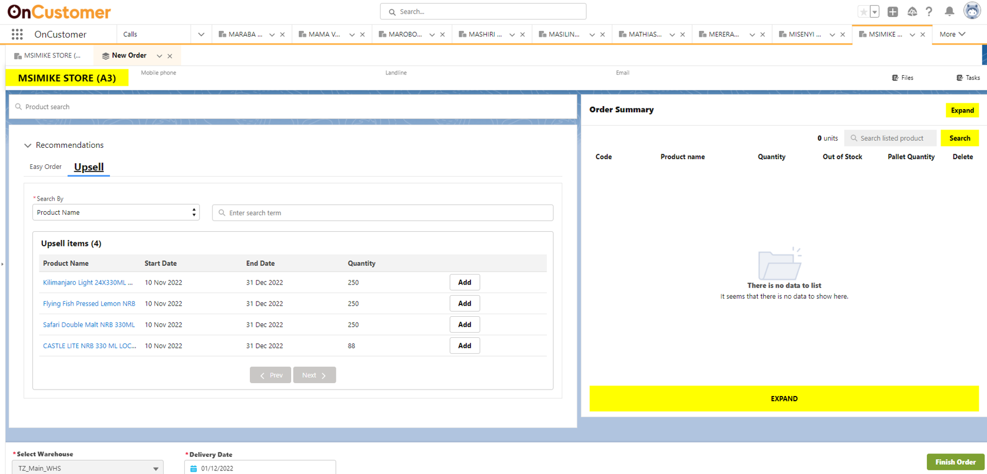
Algo Selling Integration with BEES and OnCustomer
BEES
OnCustomer
Suggested Order
Suggested Order
Upsell
Have the best recommendation perceived by customers
Support BU Commercial Strategy
Upsell

Slide 12





Suggested Order & Upsell Recommender – What’s Next
Integrate Algo selling and Pricing for optimized pricing based on recommended quantity adherence or benchmarking.
Integrate Out-Of-Stock (OOS) Replacement SKUs with the recommendations, to remove OOS SKUs and recommending replacement SKUs
Recommendation for innovation brands to encourage customer to explore new products, thereby increasing adoption rate
Linking Promotion and Discount to encourage premium brand and promote the category mix to increase Net Revenue per HL
12

Slide 13
Meaningful Calling BDR Algo Tasking

Slide 14




























Call List Optimization and Topline Protection: Overview
Framework to segment the customer base into groups of similar customers to identify the right audience for commercial initiatives and design personalized strategies
Live in South Africa
Old Process
Business Impact
Opportunities
Manual process based on huge subjective survey
Completely automated and integrated with the consumption platform
Scaling customer segmentation across multiple African markets
Non-standardized survey responses
Leveraged all the internal data with additional survey inputs
Incorporate consumer social listening data to build a richer segmentation
Heavily Reliant on BDRs Input and time consuming
Enables 360 degree view of all the important business KPIs for the customer
Use segmentation as a cross-functional brain to empower multiple commercial initiatives
No internal data is used, segments can’t be verified
Enables personalized decision-making based on the POC performance
Methodology
Customer
BDR Visit and
Survey Data Collection
Data Lake
Wholesaler
Gold Mainstream
Tavern
Internal Data
Segmentation Brain
Customer Tier
Assignment
ML Based Loyalty Tier Framework
Customer Order History
Customer
Attributes
SKU
Attributes
Price
Compliance
Mainstream Tavern
Silver Mainstream
Tavern

Slide 15



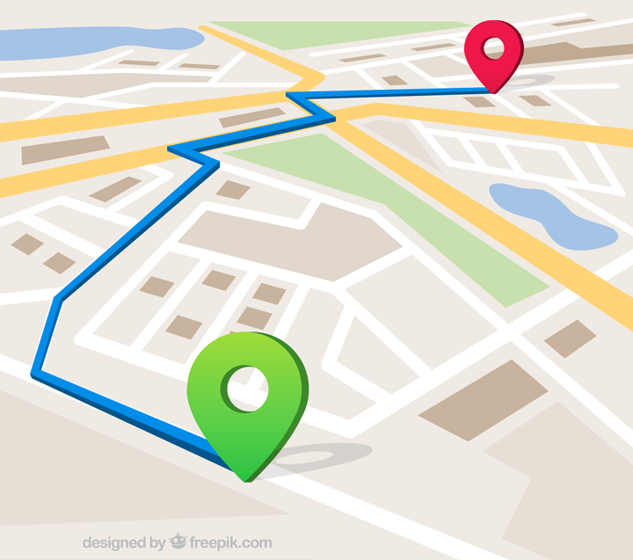






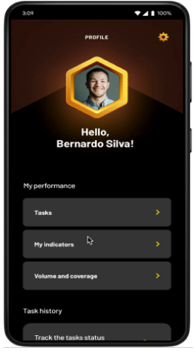




BDR Algo Tasking
BDR Algo Tasking framework is designed to assign personalized tasks to BDRs for a POC, based on POC’s Performance, POC attributes and the commercial strategy.
Live in South Africa
Data Inputs
Segmentation Brain
Visit Planning & Optimization
BDR Visit Time and Frequency
BDR Resourcing
Route Optimization
Linked to BDR Incentives
BDR
Customer Order History
Tasks universe
Task Assignment
BDR Task Schedule
POC | Type | Visit 1 | Visit 2
Moonlight Bottle Store | Counter Service | Encourage Customers to trade with SAB | Offer Trade Schemes
Maggie's Place | Mainstream Tavern | Educate customers on Upsell Benefits | Educate on BEES App and Usage
Payment Behavior
Identified attributes
Low
Volume
Audit Report
Task selection
Low
Encourage Customers to trade with SAB
Educate customer on Upsell benefits
Offer Trade Schemes
Get the first order of the month to achieve 1in 4 weeks target
Retention
High
Price Compliance
High
$1.7M
2022 Net Revenue Uplift
$0.3 M
2023 BDR Head Count Savings
BEES FORCE
integration
Category Mix

Slide 16




BDR Algo Tasking – What’s Next
Conversation scripts to BDRs through Gen AI to drive better adherence
Personalized communication scripts to BDRs based on customer’s historical adherence to task category
Image processing to validate the effectiveness of BDR Tasks
Real-time analysis of images to validate the effectiveness of completed BDR tasks
Centralized data lake to streamline all input and output data sources
BDR Tasks simulator
Simulator to understand which task will get performed by the BDR for the customer in the upcoming visit to create scenarios and better deploy the most appropriate tasks

Slide 17
Customer Target Setting & Discount Budget Optimization: Overview

Slide 18













Customer Target Setting & Discount Optimization: Overview
Tanzania
from Jun 2022
Nigeria
from July 2023
Live In :
Enable Commercial team & PPMs to set optimized volume and sales target for the Customers and maximize Net Revenue and ROI on discounts and Incentives
$ 1.7 M Annualized Net
Revenue uplift **
$ 0.9 M Annualized
Discount Saved **
28 % Avg. Reduction in
Discount per HL
11 % Avg. Reduction in
Target Deviation
Challenges
Business Impact
Solution Framework
Manual and heuristic Methodology
Fully Automated Scientific model to eliminate any human bias
Use of historical data to extract insights using seasonality and trends
No customer level target
All targets are assigned at customer level to get maximum efficiency
Incorporating state-of-the-art
forecasting techniques like Holt’s
Winter and Moving Average to build a robust model that synchronizes customer historical patterns with business demands.
Historical data and trends are not being used
Utilization of forecasting techniques enable to set precise targets through data pattern
No Relation between Target Achievement and Discount provided
Interlinking target and discount creates a feedback loop mechanism which helps with increased Sales
Establishing a system where discounts are determined according to the customer's performance & achieved target
Arbitrary target adjustment made by the local team
Guard rail range provides the PPMs with a range to set accurate targets
Note : 1. *Customer refers to the Distributors ; 2. Numbers mentioned here are for the time period YTD – Jan’23 to May’23

Slide 19









Put the numbers in green and update the numbers to 2023 ytd
Change business impact
Put SA flag
Change next steps-more of 2023
Remove stakeholders
Change current process
-any of the data is not used, no internal poc performance data is used
Impact-
Completely automated process , no manual intervention
Everything is not on subjective, obejective data, transaction history, preference towards brand, data driven approach, well defined segemnts giving us 360 view of all relevant KPIS that the business needs the customer to drive any campaigns or strategy
New segmentation poc description and also the performance
Target Setting & Variable Compensation : Process Flow
TARGET CASCADED TO CUSTOMER LEVEL
DATA FLOWS TO ALL MODELS
4 Months Moving Avg.
LOCAL TEAM ADJUSTING TARGETS
Anajayjaypf Limited
INPUT DATA
TARGET RECOMMENDATIONS
Sales Data
Holt Winter’s ETS
Setting up Guard rails
Doreen Ephron Ngowi
District | Customer | Cases Target | Lower GuardRail | Upper GuardRail
Central | PANA002 Anajayjaypf Limited | 22,847 | 19,647 | 22,847
Central | PDOR004 Doreen Ephron Ngowi | 11,324 | 10,758 | 13,589
Central | PGAS000 Gasper W Masid | 6,100 | 5,808 | 7,320
Central | PGAS002 Gasper W Masid | 13,880 | 13,146 | 14,574
Central | PGOG001 Gogetimes General Enterprises | 12,074 | 12,074 | 14,489
ARIMA
PGAS000 Gasper W Masid
Monthly LE
SARIMA
Gogetimes General Enterprises
Best target forecast model is chosen
Existing Model
Model Runs every
month with no Manual Intervention
PGAS002 Gasper W Masid
Improved & Dynamic Target Calculation Process

Slide 20


Customer Target Setting– What’s Next
Customer target setting and discount calculation at Net Revenue Level
Volume-level customer targets don’t consider the brand mix that customer is selling
Will help premium heavy customers to benefit better from target setting
Trade promotions and trade schemes based on customer target achievement
Implement data-driven strategy to optimize trade promotions and maximize ROI
Integration of Customer targets to Algo-selling and Topline Calls
Ingestion and integration of Customer targets to Algo-Selling for better recommendations
Topline calls to customers falling off their Targets

Slide 21
Call Optimization and Topline Protection

Slide 22







Call List Optimization and Topline Protection: Overview
Optimal POC-Agent Call Assignment, Intelligent Scheduling and Recommended Actions to Maximize Volumes and Reduce Churn Propensity.
Nigeria
(Live)
Tanzania
(Live)
Uganda
(Live)
Note : YTD check with gaurang
Old Process
Current Process
Business Impact
Manual and heuristic approach to create & upload the call schedule
End to End automated call schedule creation
Increased order volume and revenue uplift
No process to identify volume gaps & customer
churn
Dynamic call increase for topline customers
Reduced customer churn propensity by alerting the CXC agent
Lack of insights to CXC agents to drive meaningful conversation
Introduction of Selling Stories to provide CXC agents with customer insights
Uniform call distribution among agents
Static call schedule updated on quarterly basis
Reduced manual intervention in call schedule creation
Weekly refresh of call schedule
Nigeria 2023 Results
$1.11M Net Revenue Uplift Generated YTD
5% increase in Planned Call Effectiveness
Other non-BEES markets showing interest
Value Creation of the solution summed up from January 2023 to April 2023
% of planned calls in which order was placed. This measure reflects average of YTD

Slide 23









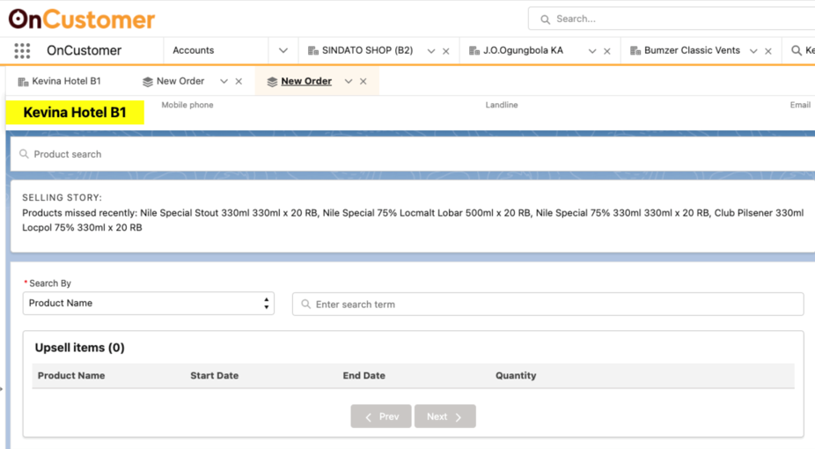
Call List Optimization and Topline Protection: Process flow
DATA INPUTS
Call History Data
OPTIMIZATION ENGINE
Optimal customer agent call mapping
Dynamic call increase for customers at risk of not meeting revenue potential
Customer insights in the form of ‘Selling Stories’
DYNAMIC CALL SCHEDULE
DEPLOYMENT
CX AGENT
Sales Order Data
Customer Attributes
Algo Selling Recommender
SKU Data
CX Agent | Customer | Call Date | Call Time | Selling Story
Maureen Mworia | Africana Pub | 01-05-23 | 9:00 | Gap from Recommended Quantity: 42 cases
Henry Kilenga | Florida Inn Bar | 02-05-23 | 9:00 | Additional Topline Call
Neema Mvungi | Bagamoyo Resort | 03-05-23 | 9:00 | Products missed recently: Hero RB 600mlx12, BetaMalt Malt Can 330mlx24
Weekly call schedule refresh & call increase for customers with topline gaps
End to end automated
pipeline to upload call schedule

Slide 24





Next Step & Future Scope
Crafting personalized selling stories by leveraging GenAI to gain customer-specific insights.
Analyzing Customer-Agent call conversation to determine fixed call duration for every mission type
Maximizing sales opportunity by leveraging key selling moments across channels (CXC, BEES, BDRs)
Optimizing call schedule by implementing real time updates
Scaling the solution to other Africa Markets
SLA

Slide 25
Customer Stock Allocation & SLOC analysis

Slide 26




Customer Stock Allocation : Overview
In Progress : South Africa
Dynamic stock allocation for each customer at a plant and SKU level to minimize out of stock (OOS) volume and align our execution to our Route to Market Strategy
Pain Points
Solution Framework
Business Impact
30%* Out Of Stock in South Africa.
Implemented an automated data-driven methodology to set SKU-level weekly limits for customers, reducing OOS issues.
Enabling consistent product availability with optimal stock allocation
Route to Market is shifting form Direct (60% 40%) to Indirect
Reduced Customer Order rejection rate
Balancing Route to Market strategy to ensure stock availability for every Customer
Reduction in overall profit margins for the business.
Increased Sales Revenue by acquiring back direct customers
Limited access to consumer insights poses challenge to customize marketing strategy
Weekly refresh & Monthly refresh of SKU limits
Customer retention is increased by minimizing OOS
*Note: Time period is after 2019.
Customer Stock Allocation 2023 Results
~40 %** decrease in average OOS order Rejection in Direct Customers
0.85 %** Volume shift from Indirect Customers to direct Customers
$299 K** Net Profit Uplift
** Note: Time period considered for the above results is Feb 2023 – Apr 2023

Slide 27








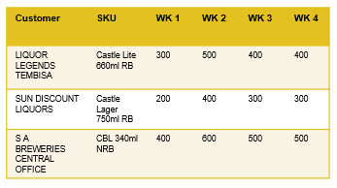





Stock Allocation – Process Flow
STOCK ALLOCATION MODEL – SLOC LEVEL
SLOC LEVEL STOCK LIMIT ASSIGNMENT
SKU | Brewery | SLOC | Vol %
Castle Lite 660ml RB | SAB Alrode Brewery | Direct Ship | 20%
Castle Lager 750ml RB | SAB Rosslyn Brewery | T1 | 30%
CBL 340ml NRB | SAB Newlands Brewery | T2 | 20%
DEPLOYMENT
Sales Orders Data
SKU Production Volumes by Plant
SLOC Allocation based on:
Historical sales
Business Strategy
PRM file
Derive the volume for each SLOC and SKU
Leveraging Business Input
Rolling 3 month Vol Avg
Sending the limits on Monthly basis
Data Inputs
STOCK ALLOCATION MODEL – CUSTOMER LEVEL
CUSTOMER LEVEL STOCK LIMIT ASSIGNMENT
Sales Orders Data
SKU Production Volumes by Plant
Customer stock allocation based on:
Historical sales
Production LE & AC
RTM Strategy
SKU level Allocation by plant based on:
Product Availability
Proximity to Customer
Dynamic threshold per Customer Segment & Brand Category
Weekly level adjustments based on stock availability & Scenario Planning Simulations
SKU Attributes​
Customer Attributes

Slide 28
Next Steps:
Approval From Business, VC, FP&A
End – End Automation through
Kedro
DataBricks
SharePoint
Potential Enhancements:
Finding a Substitute SKU if there is OOS SKU
Understanding OOS SKU and its true demand and incorporating insights into production plan – SKU Rationalization

Slide 29
Generative AI

Slide 30
Companies should choose strategically how to participate in the Gen AI ecosystem
Gen AI is not just hype, it’s here to stay
40% of all industrial processes will be transformed
70% of all jobs will be impacted
$3B+ in value for a supermajor
Gen AI is not just technology play
Business value: how it transforms processes
Op model: how it builds new capabilities & impacts people & ways of working
Ethics: responsible AI
Define competitive advantages through Gen AI
Productivity & Cost Saving
Effectiveness of decision making
Controlling new value pools
Balance between quick wins & strategic shifts
Foundation model management is key
Performance vs cost vs control
Proprietary vs open source
Buy vs boost vs build
Explainability & traceability
Accenture, Generative AI Leadership Session, page 2, May 15th
Our Gen-AI Vision
AB-Inbev is poised to redefine the industry landscape by harnessing GenAI, unlocking innovation and efficiency like never before. This isn't merely an upgrade; it's us leading a new era where real-time data-driven strategies and personalized experiences become the norm
Notes:
What we want to get...
How we are organized
Test & Learn approach
Inspiradora: This is one of a generation tech change and we need to be in the vanguard Pioneering the GenAI revolution, AB-Inbev is set to redefine industry norms. We envision transforming operations, innovating products, personalizing customer experiences, and driving robust sustainability and growth. This leap forward is not just change, it's a new era of possibility. Welcome to the future with AB-Inbev at the vanguard

Slide 31





Key take-aways
Focus on the highest potential opportunities
Gen AI is a priority for Technology- Huge potential
Global and Zones joining forces
Need of short term results while building long term
Zone SPOCs play a key role for success

Slide 32
We chose the DVF methodology to prioritise use cases & opportunities to leverage Generative AI for creating business value
Desirability and Viability assessment
Feasibility assessment
Size of the Prize: Incremental EBITDA ($M US) at run rate, considering material cost (if relevant to capability optimization)
Strategic Importance: Qualitative assessment of strategic importance of key dimensions:
Alignment to Business Strategy strategic pillars
Scale (1-5) showing capability optimization contribution to increase market share and portfolio expansion
Regional scalability
Scale (1-5) showing how transferable is the capability optimization to rest of the Zone and other regions
Once a score is given for both dimensions, the “strategic multiplier” is obtained using the following formula: sum / average of sums of all capability optimizations
Desirability and Viability
Weighted mean of a 1-5 point scale qualitative assessment made for the following four technical and implementation areas.
1
1
2
3
4
5
2
Priority #1
Less feasible
More feasible
Feasibility areas
Priority #2
Out of Box vs. Custom Trained Model
Costs and complexity to train and retrain the model
Data Security and Sensitization
Need for UI interface
Integration with Enterprise tools (i.e. Workday)
1
2
De-prioritize
3
Technical variables
4
Feasibility
5
Notes:
For Desirability and Viability, we are looking at the overall size of the prize and alignment to strategic objectives
For Feasibility in addition to the effort and complexity of the solution, we are also considering the data, security and governance aspects of building a Gen AI solution

Slide 33
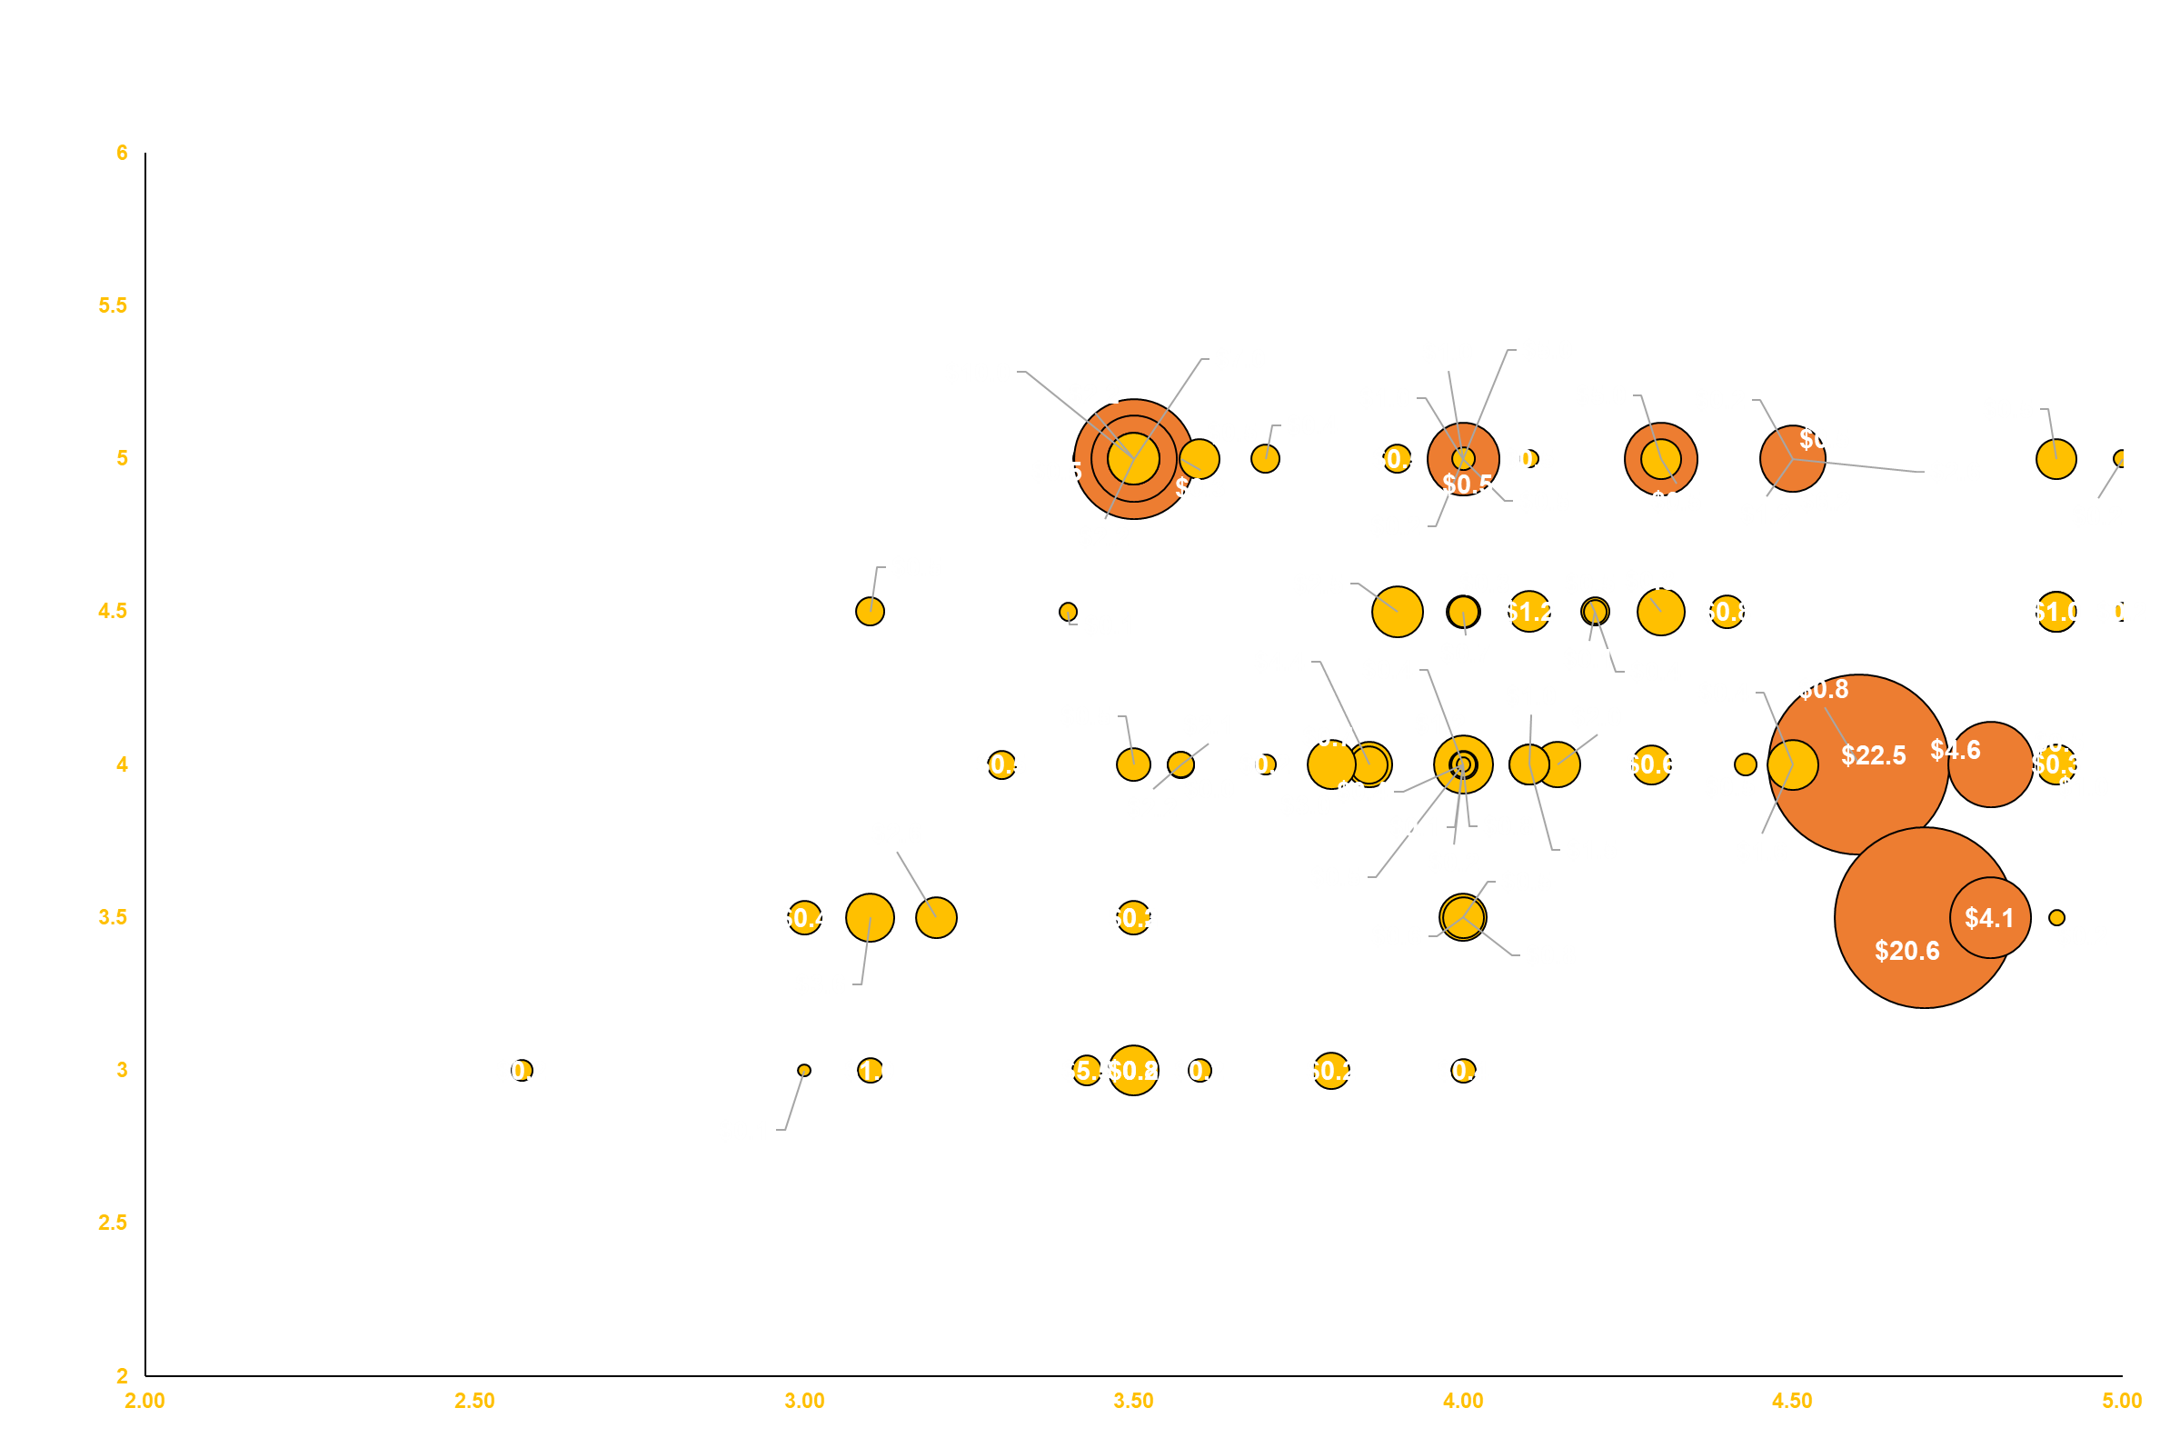

We received over 100+ ideas from multiple zones and domains for creating new features or products using Generative AI models
DVF Assessment of all Use Cases
Bubble Size Indicates EBITDA ($M)
Content Creation
Top Use Cases:
BEES Care Chatbot
Supply Problem- Solving Tool
Automated Content Creation
GenAI based Financial Reporting
Code Efficiency
Insights Gen
Desirability
Contract Analytics
BEES Care
Social Listening
View live on PowerBI With the below QR Code
SOP Supply
Feasibility
High ROI Use Cases
Notes:
We received over 100+ use cases across Zones and Domains where generative AI can make a major impact on the business
Based on our prioritization we will pick up the top opportunities in each domain and zone to further explore the value and assess through a proof of concept

Slide 34
Current opportunities being explored

Slide 35
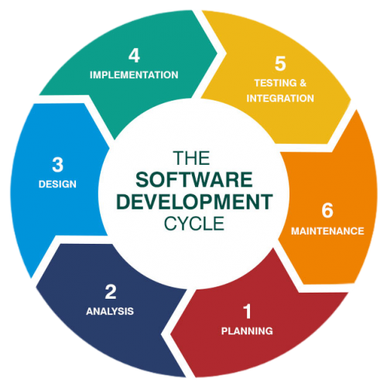


ML Ops team productivity 10X
WHY
MLOps. Team implemented productivity improvements in the LightHouse software products to successfully scale & operate them in 4 MAZ markets (MX, COL, PE, DR).
WHAT
In 2023 we need to expand to + 4 BUs (ECU, HON, ELS, PANAMÁ) in MAZ without increasing team size.
GenAI is helping us to be more efficient and go faster.
HOW
Using GitHub Copilot for Debugging code, Testing Code, Documenting Code.
Time to be saved: 8h – 32h / 160h = 20% a month

Slide 36
Insight Miner with Gen AI
Gen AI – progress and updates –2/2
1.Conversational Data Insights Engine: -
Conversational data analysis platform for generating insights using sales data, capable of addressing diverse business queries.
Key Benefits: -
Estimated reduction in the turnaround time by 50% removing dependencies on data analyst and Business analysts for basic business queries for leadership and frontline workers
A unified platform for all the business insights related to the all type of data
Engine having contextual and conversational data insight engine
Next Steps: -
Evolve it further into a unified platform, where all data-related queries can be handled in a seamless manner and pipeline
Notes:
Organizing for GenAI: Highlight the need for a cross-functional team, including leaders from data science, engineering, legal, cybersecurity, marketing, and design, among others. This team will identify high-value use cases, ensuring coordinated and safe implementation of GenAI across the organization.
Enabling a Fully Loaded Tech Stack: Emphasize the importance of a modern data and tech stack to support GenAI. Discuss the need for fluid access to data, scalable data architecture with robust governance and security, and the possibility of infrastructure upgrades.
Balancing Risk and Value Creation: Discuss the need to balance the transformative potential of GenAI with its associated risks, including potential bias and the propensity to "hallucinate". Stress the importance of ethical guidelines and risk management structures.
Applying an Ecosystem Approach to Partnerships: Highlight the benefits of partnering with other companies to accelerate GenAI integration and prevent vendor lock-in.
Focusing on Required Talent and Skills: Discuss the need for upskilling the current workforce and hiring new talent with the necessary skills for GenAI implementation. Highlight the importance of training and education to help employees understand how to effectively use GenAI tools.

Slide 37




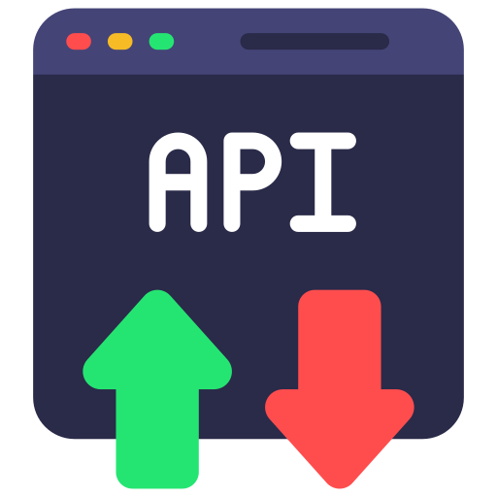

GenScribe: Architecture and process Flow
GenScribe is a dynamic selling story generation engine that leverages the power of generative AI to empower BDRs and CXs. The objective of this tool is to design a data backed story, looking into the historical data of customer
In Progress : South Africa
RLHF Agent
Sampled Training Data
Training
LLM-Model:
In context Learning
Input: BEES grow Missions
Data Inputs
No
Output: Selling Story and update of Dictionary
Sales Orders Data
BEES Force Missions
Yes
Check if Mission is part of existing list
Dictionary of BDR missions and Selling stories
Exposing data as API
SKU Attributes​
Customer Attributes
Consumption Platform: BEES Force
RLHF Agent: Reinforcement Learning from Human Feedback

Slide 38
Support Required Slide
Support from BEES team to assist in quantifying the Incremental MaCo for Algo Selling BEES Solution in Tz and UG
Support from AFR team on promptly notifying us on any market level changes or macro economical shifts
Assitance required to collaborate with BEES team in collaborating

Slide 39
Support Required
Support required from BEES team in quantifying the incremental MaCo for Algo Selling solution that has been live since, Jun’22 in TZ and UG
Assistance from Africa country teams on effectively communicating any customer or market-level changes and macroeconomic shifts
Partnering with BEES Grow team to integrate Topline Solution in TZ and UG
Establish a robust change management process ensuring there is a backup on any crucial task where failure could have a business impact, effective communication on developing a process startergy changes and

Slide 40
Appendix

Slide 41
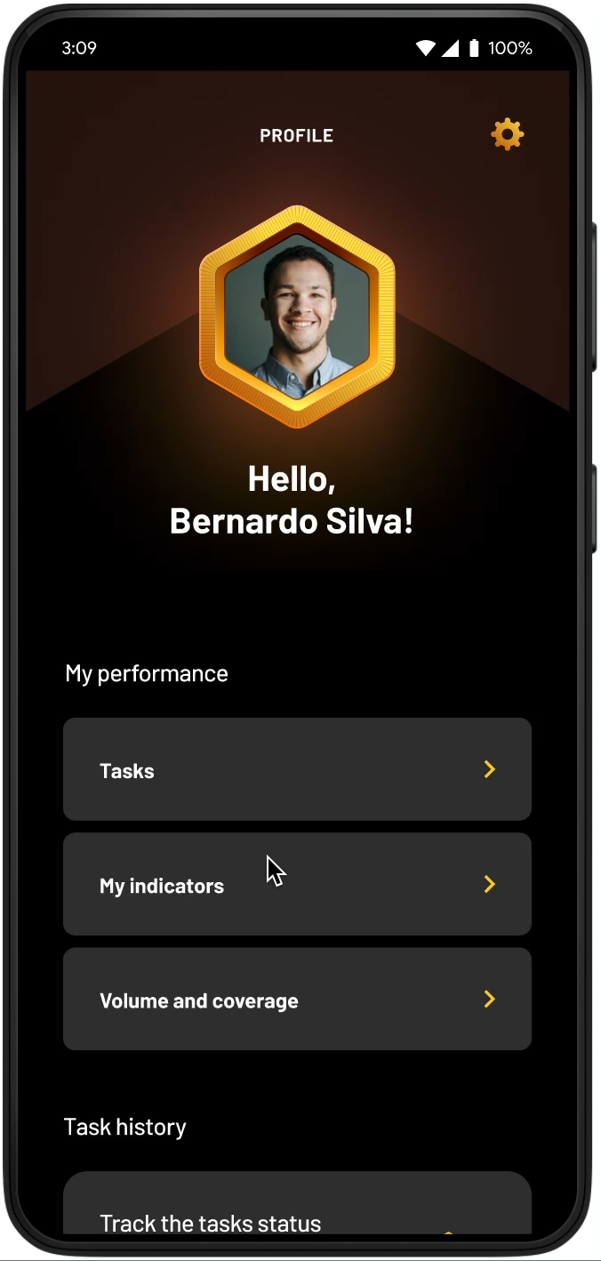
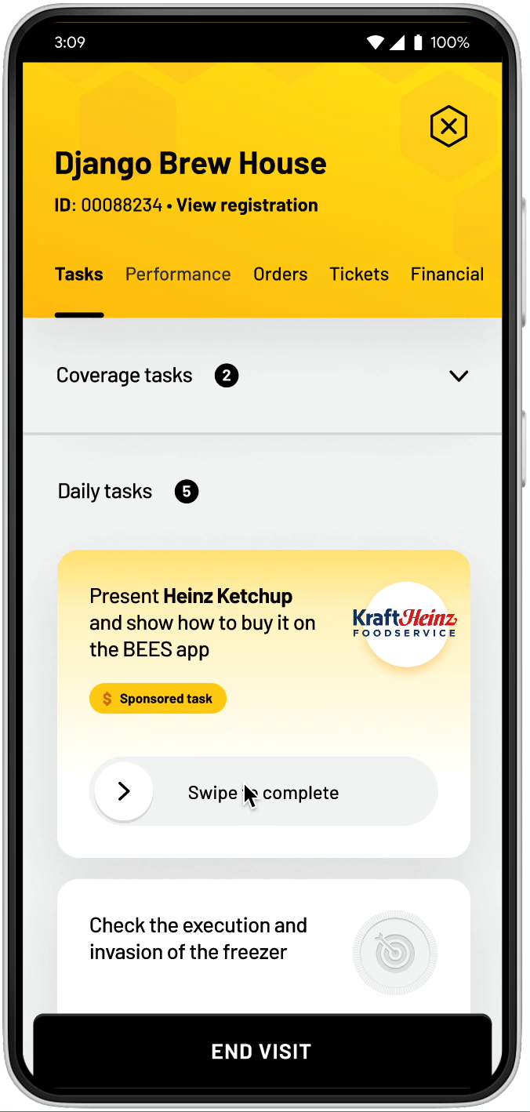
BDR Algo Tasking integration with BEES Force
BDR Profile and Task Summary
How the BDR will use the app while performing tasks

Slide 42





Governance Routines
Theme
Cadence
Participants
Discussion Points
Leadership Reviews
Exec. Sponsor
Analytics Leadership
Leadership Buy-In on Analytics Plan, Progress and Impact
Highlighting Success Stories
Quarterly
VPs/BU President
Analytics
BU
Goal and priority alignment
Progress monitoring
Decision Making
Escalation handling
Exec. Sponsor
Project Leads
Steering committee
Analytics Leadership
Transformation Director
Product Owner
Exec. Sponsor
Project Leads
Monthly
Project status update
Risks and dependencies
Roadblock clearing
Alignment on next steps
Analytics
BU
Progress Update
Product Owner
Transformation Manager
Data Scientists & Engineers
Project Leads
Weekly
Solution Brainstorming
Data gathering
Request management
Business review preparation
Analytics
BU
Project Execution
Weekly /
Daily need basis
Data Scientists & Engineers
Project Team

Slide 43




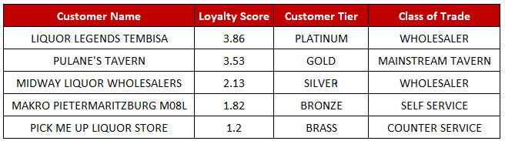

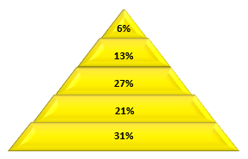
Customer Segmentation Methodology
Slide to be moved to appendix
Generate well-defined Customer Tiers by considering various factors related to customer engagement to develop a holistic view of the entire customer base
Data Used
Methodology
Outcome
Sales Data
Sales Volume
Volume Growth
Brand Mix
Retention
Step 1: Calculating Loyalty Index Score
Platinum
Step 1: Calculating Loyalty Index Score
Volume
30%
Category Mix
20%
Silver
Gold
Retention
30%
Credit Score
20%
Bronze
Composite Score(0-5) = Sum(Factor Value * Weight)
Step 2
Segment customers into Platinum, Gold, Silver, Bronze & Brass based on Composite Score
Payment Behaviour
Average Days Invoice Delayed
3.9 - 5 : Platinum
Customers grouped into well defined Tiers based on Loyalty Index Score
Segments to be used as a crucial input to define and drive multiple commercial initiatives
3.4 – 3.9 : Gold
2.0 – 3.4: Silver
0 – 2: Bronze
0 : Brass
43

Slide 44
Partners & Stakeholders collaborating with

Slide 45
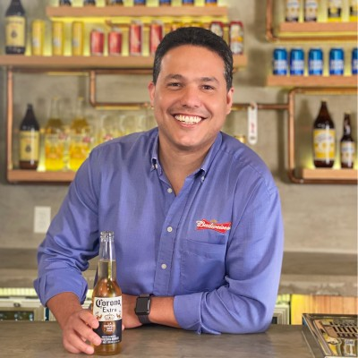


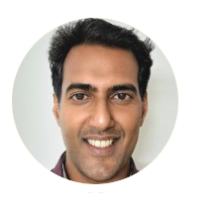



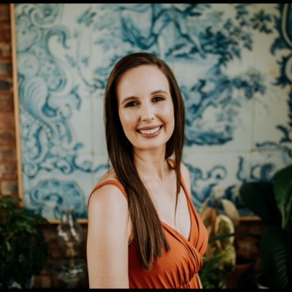

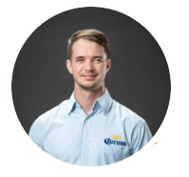
We are well positioned to succeed on our ambition for Africa with Guidance and Support from our Leadership and Partners through their Domain Expertise and Market Knowledge
Analytics Leadership
BrewDat
Felipe Aragao
Global VP,
Data Analytics
Helen Place
Product Owner
BrewDat Commercial, Africa
BEES
Ruvan Avenant
Product Manager
B2B & BEES
Eon Alers
Data & Architecture
Director - Africa
Sajith Kurup
Global Director
Analytics - Commercial
GCC
Rahul Prakash
Director Analytics
Sales & Distribution
Priyanka Ganapathy
Director
Commercial Operations
Africa Commercial Leadership
Lorraine Van Zyl
RTM & Tech Sales Director
- BU South Africa
Molly Horn
Commercial Director
- BU East Africa
Herman Franken
RTM, Tech Sales
& Trade Marketing Director
- BU West Africa
RTM
Sales
Tech Sales
RGM
CXC
Trade Mktg

Slide 46



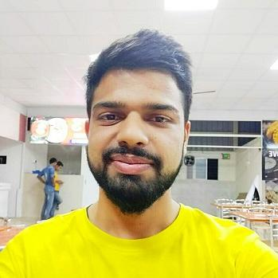
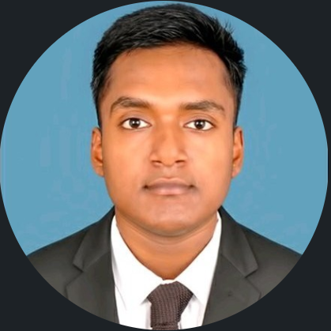








AFR Commercial Analytics – Dream Team
Planning and Delivery
Shri Vijay Kumar
Product Owner
Deepesh Singh
Senior Manager - Tech
R&D and Solution Development
E2E Product Development
Diksha BM
Program Specialist
Manuj Mehrotra
Data Scientist
Bikram Das
Data Scientist
Avinash
Senior Software Engineer
Nandha Kumar
ML Engineer
Karthik
Data Scientist
Saket Srivastawa
Data Scientist
Digant Thakur
ML Engineer
Krishnaveni, Muddukuri
DevOps Engineer
Nikhil
Data Scientist
Gaurang
Data Scientist
Swostiman Mohapatra
Data Engineer

Slide 47
Value Creation Update 2022-2023 YTD*

Slide 48







AFR Commercial Analytics –2023 YTD Value Creation Summary
EBITDA VC Target
EBITDA Value Achieved
Capabilities Deployed
Algo Selling BEES
Target Setting
$ 8 M
$ 5.5 M
TZ
UG
TZ
Algo Selling CX
Topline Protection
TZ
UG
NG
MZ
GH
ZM
TZ
NG
UG
BDR Algo Tasking
Customer Segmentation
ZA
ZA
Use Case
Revenue
EBITDA
Algo Selling (Suggested Order& Upsell)
$ 4.4 Mn
$ 2.0 Mn
BDR Algo Tasking
$ XX Mn
$ 1.3 Mn
Africa Commercial Analytics
Target Setting
$ 1.9 Mn
$ 1.06 Mn
Topline Protection
$ 1.1 Mn
$ 0.6 Mn
$ XX M
Total Revenue
$ XX M
Total EBITDA

Slide 49
Thank You

Slide 50
Appendix

Slide 51



Team Structure – 15 Member Strong Team to Execute on our 2022 Roadmap for Africa Commercial Analytics
AFR Commercial Analytics – Dream Team
Planning and Delivery
Shri Vijay Kumar
Product Owner
Shankar Ganesh
Manager - Analytics
Deepesh Singh
Senior manager - Tech
R&D and Solution Development
E2E Product Development
R&D and Solution Development
Komal Chandran
Scrum Master
Abhinav Mahaptra
Data Scientist
Manuj Mehrotra
Data Scientist
Avinash
Senior Software Engineer
Nandha Kumar
ML Engineer
Diksha BM
Business Analyst
Bikram Das
Data Scientist
Saket Srivastava
Data Scientist
Digant Thakur
ML Engineer
Krishnaveni, Muddukuri
DevOps Engineer
Karthik
Data Scientist
Gaurang
Data Scientist
Pranay
Data Scientist

Slide 52
We are well positioned to succeed on our ambition for Africa with Guidance and Support from our Leadership and Partners through their Domain Expertise and Market Knowledge
Analytics Leadership
BrewDat
Felipe Aragao
Global VP,
Data Analytics
Helen Place
Product Owner
BrewDat Commercial, Africa
BEES
Ruvan Avenant
Product Manager
B2B & BEES
Eon Alers
Data & Architecture
Director - Africa
Sajith Kurup
Global Director
Analytics - Commercial
GCC
Rahul Prakash
Director Analytics
Sales & Distribution
Priyanka Ganapathy
Director
Commercial Operations
Africa Commercial Leadership
Lorraine Van Zyl
RTM & Tech Sales Director
- BU South Africa
Molly Horn
Commercial Director
- BU East Africa
Herman Franken
RTM, Tech Sales
& Trade Marketing Director
- BU West Africa
RTM
Sales
Tech Sales
RGM
CXC
Trade Mktg

Slide 53
Next Step & Scope
Optimizing call schedule by implementing real time updates
Maximizing sales opportunity by leveraging key selling moments across channels (CXC, BEES, BDRs)
Crafting personalized selling stories by leveraging GenAI to gain customer-specific insights.
Analyzing Customer-Agent call conversation to determine fixed call duration for every mission type
Optimization of Agent Call Capacity by analysing Customer Call Agent conversations and customer order behavior. – setting call time at agent lecel for each mission as we have in bdr
Customer – Call Agent Chat: Analyse Customer – Call agent chats to prioritize issues, understand complaints, scan customer messages for keywords and submit automatic responses
Scaling the solution to other Africa Markets
Combine point 1 and 2
3rd point Emplot Gen AI
Remove Chatbot

Slide 54


Transform the Commercial decision-making in Africa zone by embedding Analytics across our key customer, consumer touchpoints and RTM processes to unlock and capitalize on valuable business opportunities across various African markets.
Check with Swostiman on data ,
NR,
VC
Strong focu
Talk about effieceny
Ambition: Consolidating a fully End-to-End Smart Commercial Model for Africa enabled by Analytics
Africa Commercial Analytics Machine
Driving Value Creation through Analytics
Route to Market Transformation
What will define Success?
Consumer & Customer Behaviors to inform Commercial Strategy
Interconnected Brain Leveraging LOLA Platform
Granular Actions & Recommendations to serve as a playbook for decision making
Unlocking $50 Mio EBITDA Opportunity
5% Incremental NR through algorithms
70% NR influenced through algorithms
From Heuristics to Scientific Decision-Making based on Data
Embed Intelligence across Processes and WoW
Empowering BDRs & CXC through Targeted Actions by POC
Consumer & Customer Behaviors to inform Commercial Strategy
Interconnected Brain Leveraging LOLA Platform
Granular Actions & Recommendations to serve as a playbook for decision making
Unified Data Layer
Integration with Consumption Platforms (BEES, OnCustomer)
Tech Backbone
Full line of sight into Commercial Data captured across various processes
Collating and Cataloguing Commercial KPIs from multiple sources and platforms
Connecting to all major Data Lakes, Reporting DBs and ERP platforms:
End to End Analytics Product integrated with Downstream Consumption Platforms
Single Source of Truth for all Commercial Decision Makers on platforms like BEES Customer, BEES Grow, BEES Force, OnCustomer, etc.
Powering Key Insights across platforms used by Commercial Teams, Customers & Consumers
Strong focus and capabilities around R&D Experimentation, Productization and Impact Measurement
Enablers
Partnering with BEES, BrewDat, GCC and Transformation Teams to Accelerate Analytics Adoption and Value Creation

Slide 55

Africa Commercial Analytics
Check with Bikram, are we refreshing segmentation
Vijay to get back on non digital
2024Collaboartion with other team on pricing ,
Analytics getting closer to business/consultant
Ytd numbers
Talking header points
LOGO : something like Catexpert logo embedding Analytics to solve Business problem in Africa Comm
Distinct markets
Solution and not product
2023 – Algo tasking with CX also if any other 2023 alignment
Capital letters
Segouel UI – font
Integration with BEES
Ongoing solution deliver – remove it off
Leverage AI to solve business prbm- genAI
Integration of analytics into additional business and commercial function
Bottom partnership function in proper order
Gen AI point on focus are for 2024
The Journey So Far…
AFR Comm Program 2022
AFR Comm Program 2023
2024 Focus Area
Delivered 6 analytics capability in different Africa markets
Delivering 6 analytics solution that is operational across 7 Africa markets
Enhancing existing solution and bringing in State of art models
Introduced Customer Stock Allocation & Target Setting solution as new capabilities in SA and NG resp
Integrating GAC’s Solution in different BEES Platforms once launched in Africa Markets
Developed end to end analytics solution and integrated on platforms like BEES and OnCustomer
Enhanced Algo selling capability by integrating the Lola GC model to improved the performance and accuracy
Scaling the solution to other Africa Markets
Leveraging GenAI to solve business problems
$10Mn EBITDA through analytics use cases
Working on linking BDR Algo Tasking with CX Integration and designing a framework to optimize the BDR/CX Incentives Program in South Africa.
Integration of analytics into additional business and commercial function
Tracking Business KPIs to assess the solution effectiveness & business outcomes.
Exploring new market opportunity to integrate with analytics to drive operation analytics
$XX Mn YTD EBITDA through analytics
Linking Algo Tasking and CX Integration & designing framework to optimize BDR/CX Incentives Program in SA
BEES
BrewDat
OnCustomer
GCC
VC approval
Partnering with BEES, BrewDat, GCC and Transformation Teams to Accelerate Analytics Adoption and Value Creation

Slide 56


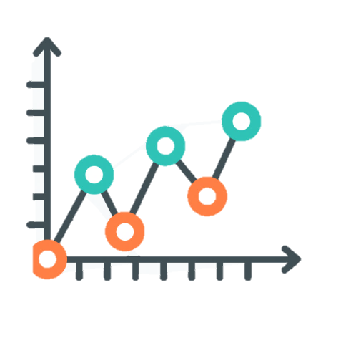






Target Setting : Proposed Enhanced Process Flow
TARGET CASCADED TO CUSTOMER LEVEL
DATA FLOWS TO ALL MODELS
4 Months Moving Avg.
LOCAL TEAM ADJUSTING TARGETS
Anajayjaypf Limited
INPUT DATA
Setting up Guard rails
SAMPLE TARGET RECOMMENDATIONS
Sales Data
Holt Winter’s ETS
Doreen Ephron Ngowi
District | Customer | Cases Target | Lower GuardRail | Upper GuardRail
Central | PANA002 Anajayjaypf Limited | 22,847 | 19,647 | 22,847
Central | PDOR004 Doreen Ephron Ngowi | 11,324 | 10,758 | 13,589
Central | PGAS000 Gasper W Masid | 6,100 | 5,808 | 7,320
Central | PGAS002 Gasper W Masid | 13,880 | 13,146 | 14,574
Central | PGOG001 Gogetimes General Enterprises | 12,074 | 12,074 | 14,489
ARIMA
PGAS000 Gasper W Masid
Monthly LE
SARIMA
Gogetimes General Enterprises
Best target forecast model is chosen
Existing Model
Model Runs every month with no Manual Intervention
PGAS002 Gasper W Masid
Improved & Dynamic Target Calculation Process

Slide 57
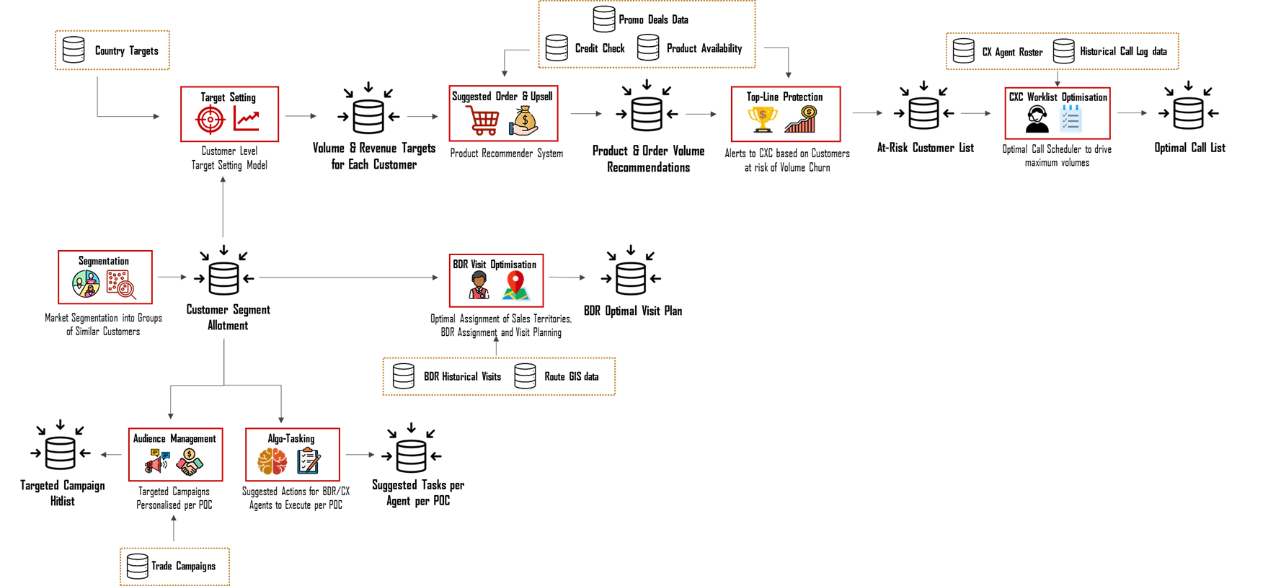

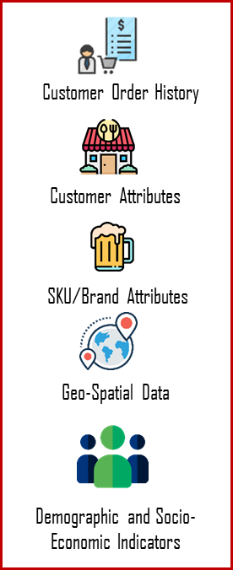






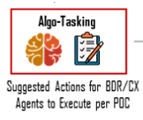
Commercial Analytics Brain
Stock allocation output going to Suggested Order,
Remove BEES logo end point
Convert image to .svg
Solution Architecture
Input Data
End Points

Slide 58
Africa Commercial Analytics Program
1. 5.8 ytd
2021
Delivered Suggested Order in 6 ROA Markets
$3.6M EBITDA Value Creation
2 Data Scientists Part of Larger Team
Africa
Commercial
Analytics
2022
6 Analytics Capabilities
$10M EBITDA Value Creation
Dedicated 15 Member Team(DS, MLE, DE) for Africa Commercial
2023 YTD*
7 Analytics Capabilities
$5.5 M YTD* EBITDA Value Creation
Dedicated 10 Member Team(DS, MLE, DE) for Africa Commercial
Note : * YTD represents periods between Jan to May'23
Notes:
Vijoe

Slide 59
Transform the Commercial decision-making in Africa zone by embedding Analytics across our key customer, consumer touchpoints and RTM processes to unlock and capitalize on valuable business opportunities across various Africa markets.
Remove Light house
BrewDat color change
Efficiency & Productity segment
4. Incorporate github co pilot
5. Merge 1st & 3rd and put GenAI efficence in 3rd block
6. Second block put finance
Data block – Swostiman’s help
NR,
VC
Strong focu
Talk about effieceny
Ambition: Consolidating a fully End-to-End Smart Commercial Model for Africa enabled by Analytics
RTM & Africa Commercial Analytics Machine
Driving Value Creation through Analytics
Productivity & Efficiency
What will define Success?
Consumer & Customer Behaviors to inform Commercial Strategy
Adaptability and Flexibility to changing market dynamics & emerging opportunity
Expanding BDRs & CXC efforts through Targeted Actions to unlock untapped potential
Unlocking 50 Mio EBITDA Opportunity
5% Incremental NR through algorithms
70% NR influenced through algorithms
Refining the VC methodology to quantify impact at volume uplift Alignment with Country Director convert at a Budget rate
Elevating performance levels in Process and WoW
Leveraging GenAI to extract actionable insights uncovering market trends
Automating & Streamlining data processing workflows
Unified Data Layer
Integration with Consumption Platforms (BEES, OnCustomer)
Full line of sight into Commercial Data by connecting to all major Data Lakes, Reporting DBs and ERP platforms
Embracing to Data Mesh Architecture enabling streamlined data governance & Agile Data Culture
Developing an Fully automated, scalable and robust capability pipeline for seamless data delivery
Tech Backbone
End to End Analytics Product integrated with Downstream Consumption Platforms
Single Source of Truth for all Commercial Decision Makers on platforms like BEES Customer, BEES Grow, BEES Force, OnCustomer, etc.
Powering Key Insights across platforms used by Commercial Teams, Customers & Consumers
Strong focus and capabilities around R&D Experimentation, Productization and Impact Measurement
Enablers
Partnering with BEES, BrewDat, GCC and Teams to Accelerate Analytics Adoption and Value Creation

Slide 60

Algo Selling (Suggested order and Upsell)
Drive recommendations in BEES, tele-sales platforms & support CX teams in upselling customer orders by providing upsell and cross-sell recommendations by leveraging customer order history, product data and customer data
Ytd 2023
KPIS
One Pager – Objective, Benefits/ Business, Lola integration, Impact/VC Number, KPI Number
Next Steps, Future Scope
Live In:
Tanzania
from Jan 2021
Nigeria
from April 2021
Uganda
from July 2021
Mozambique
from July 2021
Ghana
from Sep 2021
Zambia
from Dec 2021
Methodology:
Recommendations are uploaded to BEES Lite & OnCustomer Platform
Leveraged by CX agents during sales call with customers to recommend new products
End-to-end automated pipeline using Azure DevOps
Customer
Customer places order through BEES
Intelligence fed to ordering platforms
Quick Order Recommendation Model
New Product Recommendation Model
Business Logics
to prioritize based on obsolescence risk or OOS
Customer places order through CX agent
CX agent
Transaction data from Ordering Platform
External Data
$5.2M YTD*
2022 Net Revenue Uplift
Note : * YTD represents periods between Jan to May'23

Slide 61
Customer Target Setting & Discount Optimization: Overview
Tanzania
from Jun 2022
Nigeria
from July 2023
Live In :
Enable Commercial team & PPMs to set optimized volume and sales target for the Customers and maximize Net Revenue and ROI on discounts and Incentives
Put the numbers in green and update the numbers to 2023 ytd
First 2 updated
$ 1.7 M Annualized Net
Revenue uplift **
$ 0.9 M Annualized
Discount Saved **
28 % Avg. Reduction in
Discount per HL
12 % Avg. Reduction in
Target Deviation
Challenges
Business Impact
Solution Framework
Manual Methodology
Fully Automated Scientific model to eliminate any human bias
Use of historical data to extract insights using seasonality and trends
No customer level target
All targets are assigned at customer level to get maximum efficiency
By using State-of-the-Art Forecasting techniques like Holt’s Winter, Moving Average, etc. to build a richer model syncing both customer historical patterns and business demands
Historical data and trends are not being used
Forecasting techniques helps us provide much more accurate targets using data patterns
No Relation between Target Achievement and Discount Provided
Interlinking target and discount creates a feedback loop mechanism which helps with increased Sales
By creating an environment where discounts are calculated based on the Target achieved by the customer
Arbitrary target adjustment made by the local team
The adjustments of targets within guardrails helps removing manual favouritism
Note : 1. *Customer refers to the Distributors ; 2. Numbers mentioned here are for the time period
Notes:
Change business impact
Put SA flag
Change next steps-more of 2023
Remove stakeholders
Change current process
-any of the data is not used, no internal poc performance data is used
Impact-
Completely automated process , no manual intervention
Everything is not on subjective, obejective data, transaction history, preference towards brand, data driven approach, well defined segemnts giving us 360 view of all relevant KPIS that the business needs the customer to drive any campaigns or strategy
New segmentation poc description and also the performance

